Slide 1
Internet and Web Programming
Module 1 - Introduction to Internet
Dr. Leninisha Shanmugam,
VIT Chennai

Slide 2
Contents
Introduction to Internet
Networks Infrastructure
Web Organization and Addressing
Dr. Leninisha Shanmugam VIT Chennai

Slide 3

Web based Information System
Disseminating all kind of Information
to anybody, anytime, anywhere or
to all, always, all over world
24/7 availability creates high impact in all fields
Online teaching and learning, Virtual office, Marketing, selling, getting customer reviews,
e-banking, payment portals, e-shopping, online shopping, ticket reservations, e hospitals etc.
Dr. Leninisha Shanmugam VIT Chennai

Slide 4
Website Current Trends and Needs
Challenges…
Customized websites (Amazon ,Flipkart, based on search)
Personalized websites ( online courses based on area of interest, profile)
Interactive websites (Games, Designing product eg Cyclemen)
Navigational websites (Google Map, Google earth, Open Streetview)
Regional Language (Tamil, Hindi…)
Platforms- Desktop, Phone, Tablets
Browsers – Google, Internet Explorer, Mozila with various versions
Dr. Leninisha Shanmugam VIT Chennai

Slide 5
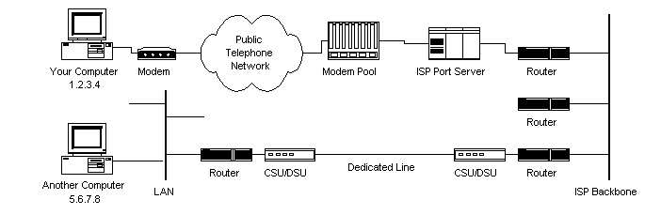
Internet
Platform - web based information system.
Internet connects world –universities, government offices, corporations, libraries,
research labs, and even individual homes through IP
https://web.stanford.edu/class/msande91si/www-spr04/readings/week1/InternetWhitepaper.htm
Dr. Leninisha Shanmugam VIT Chennai

Slide 6
Internet …..
Internet - hardware parts
Computers, Laptops, Mobiles through wired or wireless connections.
Web - software parts
Websites connected through URL addresses.
URL - Uniform Resource Locators — an unique address –
global identifier to a resource on the Web.
    HTTP Protocol
    Domain name e.g., www.google.com.
Dr. Leninisha Shanmugam VIT Chennai

Slide 7
Web vs Internet
Internet | Web
Internet is network of computers | World wide Web is networks of websites
Transfer the contents | Access the information
Layered System of Protocols: 1.Application Layer – Data transfer 2.Transport Layer - Communication 3. Network Layer – Route | To link with the internet, HTML – webpage creation HTTP – Transfer Protocol URL – Address of Resource. Server- Data Storage Client – Web browsers
Dr. Leninisha Shanmugam VIT Chennai

Slide 8
History of Internet
1969 - Advanced Research Project Agency Network (ARPANET).
  - communication among the various bodies of government.
  1972 - ARPANET spread over the globe with 23 nodes (Host)
  - located at different countries, became as Internet
  - TCP/IP protocols, DNS, WWW, browsers, scripting languages etc.,
  - medium to publish and access information over the web.
Dr. Leninisha Shanmugam VIT Chennai

Slide 9
Internet Organized by …
  No one is the owner of the Internet
    ICANN- The Internet Corporation for Assigned Names and Numbers
    - IP address space allocation, protocol parameter assignment,
    domain name system management, etc.
  ISOC - The Internet Society
  - long –term coordination with internet development.
  IETF - Internet Engineering and Task Force
  - improving the Internet’s quality and performance.
Dr. Leninisha Shanmugam VIT Chennai

Slide 10
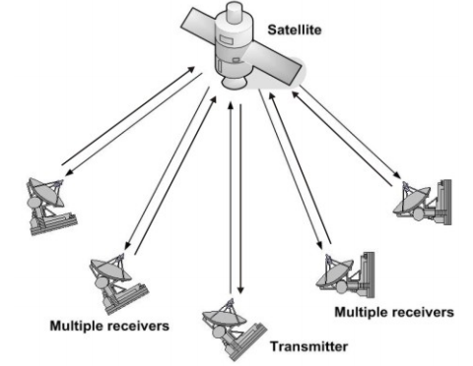
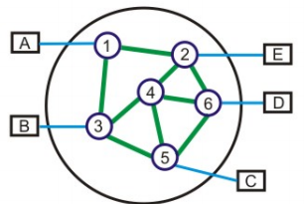
Computer Networks….
Broadcast network
- All machines will receive short messages, called packets
Point-to-point networks
- source-destination pair for reliability
- switching node to node until reach the destination.
Dr. Leninisha Shanmugam VIT Chennai

Slide 11
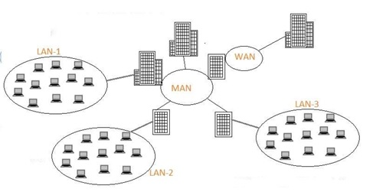
LAN, MAN and WAN
LAN - single office/ building / campus.
MAN - entire city / company connects its
offices in a city.
WAN - country / continent /whole world.
Dr. Leninisha Shanmugam VIT Chennai

Slide 12
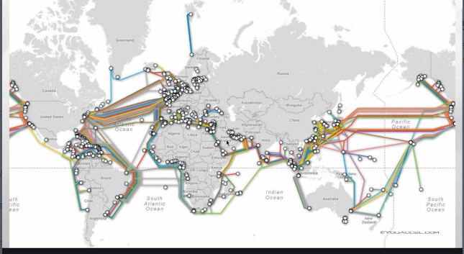
How Internet works?..
Internet - transmission of data packets.
Data packets – Data in any form( emails, Files, or Webpages)
- Address of sender and receiver - unique IP address
Dr. Leninisha Shanmugam VIT Chennai

Slide 13
Unique IP Address
Internet Service Provider (ISP), - temporary IP address - duration of dial-in session.
- permanent IP address LAN
Computers are connected to the Internet, has a unique IP address
(eg 10.11.11.111 string of numbers separated by periods.).
IP address like a phone number for your mobile phone.
Dr. Leninisha Shanmugam VIT Chennai

Slide 14
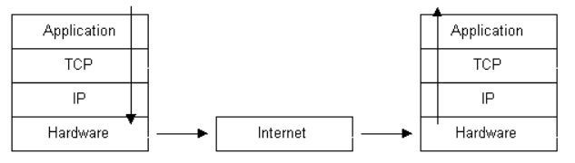
TCP / IP Stack
Application Protocol - WWW, e-mail, FTP
Transmission Control Protocol (TCP) - TCP directs packets to an application - port number.
Internet Protocol Layer - IP directs packets to a specific computer using an IP address.
Hardware Layer - Converts binary packet data to network signals and back.
(E.g. ethernet network card, modem for phone lines, etc.)
Dr. Leninisha Shanmugam VIT Chennai

Slide 15
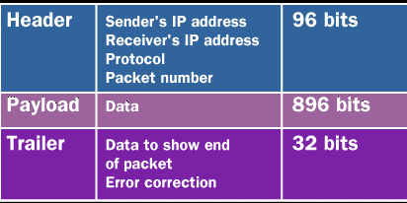
Data Packets…
Dr. Leninisha Shanmugam VIT Chennai

Slide 16
Internet Address for sending Data Packets
Computer connected in Internet follows the TCP/IP protocol.
  IP (Internet Protocol)- Route information to the proper address.
    TCP (Transmission Control Protocol) – Facilitates the transmission of Data packets. Ensures no information is missing.
Finding a file on the Internet is similar to finding the location of an individual in a city;
- Internet address - userID@hostcomputer
- example deancc.scse@vit.ac.in
Dr. Leninisha Shanmugam VIT Chennai

Slide 17
Path of Data Packet from Sender to Receiver
Message (“Hello”) - Application protocol (Mail, SMS, File, etc).
Break the message into data packets.
Application Layer to TCP layer - assigned a port number depends on application.
TCP layer to IP layer - each packet receives it's destination address, like 10.11.11.111.
ISPs router - to another router depends upon destination.
Packets reach destination 10.11.11.111.
Destination computer's TCP/IP stack and work upwards to reach application protocol.
Removes stripped data such as IP address and port number
Packets have been re-assembled into their original form, "Hello”
Dr. Leninisha Shanmugam VIT Chennai

Slide 18
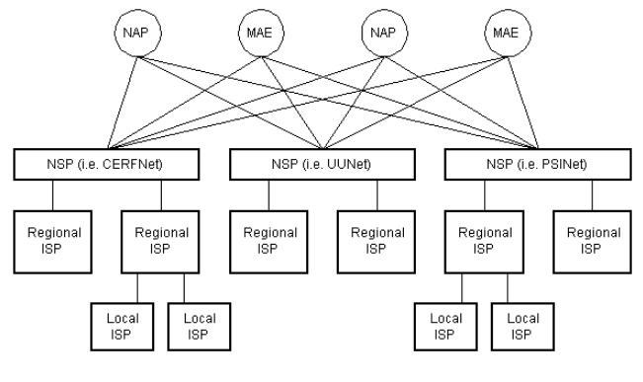
Inter-Networking Infrastructure
Dr. Leninisha Shanmugam VIT Chennai

Slide 19
Networking Infrastructure
ISP - Internet Service Providers– maintains pool of modems for dial-in
customers. (Airtel, BSNL)
NSP - Network Service Providers - backbone provider, AT&T, NTT
- customers of NSPs are internet service providers.
- peers with other NSP for exchange of packet traffic .
NAP - Network Access Points –interconnect the NSPs.
MAE - Metropolitan Area Exchanges - interconnects NAPs .
Dr. Leninisha Shanmugam VIT Chennai

Slide 20
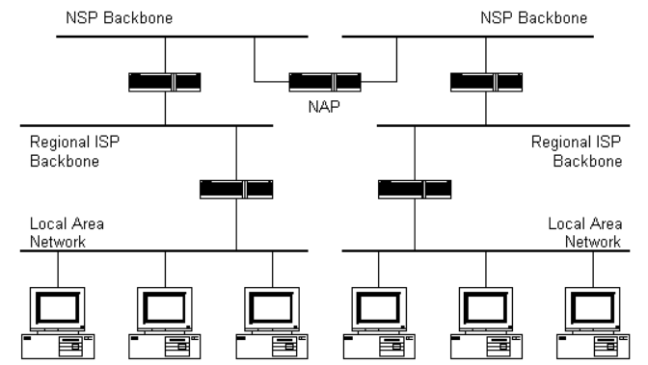
Internet / Network Architecture
Router
Dr. Leninisha Shanmugam VIT Chennai

Slide 21
Routers – switches packet
A router is connected between backbones to route packets between them.
NSP backbones at the top are connected at a NAP.
- several sub-networks, At the bottom are two local area networks with computers attached.
- packet arrives at a router, the router examines the IP address
- IP address is not found, then the router sends the packet on a default route
Packet is routed upwards until it reaches a NSP backbone.
- journey 'downward' through smaller and smaller networks until it finds it's destination.
Dr. Leninisha Shanmugam VIT Chennai

Slide 22
Web Addresses
The web address allows us to identify a computer on the network.
  Domain Name System (DNS): Domain name is a readable computer address
  that identifies the location of a computer on the internet.
  Internet Protocol Addressing (IP Address): A unique 32-bit address is assigned to
  each computer that is connected to the internet.
Dr. Leninisha Shanmugam VIT Chennai

Slide 23
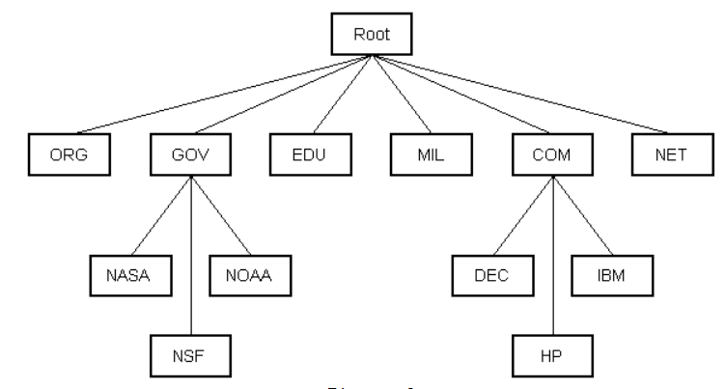
Domain Name Services (DNS)
Dr. Leninisha Shanmugam VIT Chennai

Slide 24
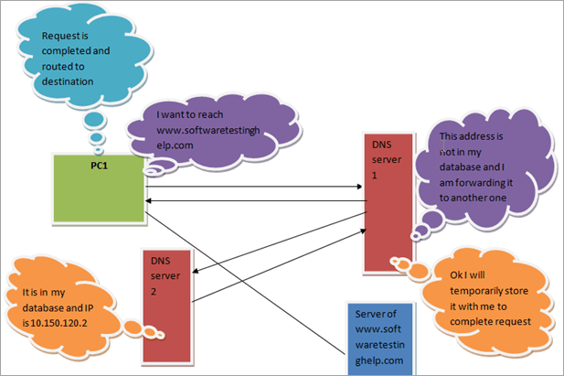
Domain Name Services (DNS)
https://www.softwaretestinghelp.com/dns-ftp-smtp-mime-protocols/
Dr. Leninisha Shanmugam VIT Chennai

Slide 25
IP Address
An IP address is a 32 bit sequence of 1s and 0s.
A way to identify machines on a network
  A unique identifier
  A numerical label
IP address consist of four sections, ( 0 to 255)
Five classes of IP Addresses : A, B, C, D, E
    Class A - reserved for Governments
    Class B - reserved for medium companies
    Class C - reserved for small companies
    Class D - reserved for multicasting
    Class E - reserved for future use
Dr. Leninisha Shanmugam VIT Chennai

Slide 26
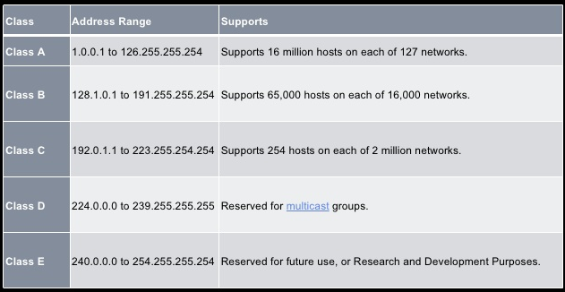
IP Ranges
Dr. Leninisha Shanmugam VIT Chennai

Slide 27
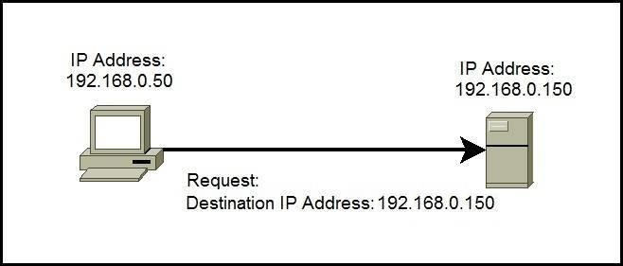
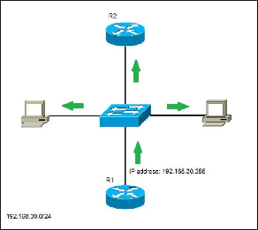
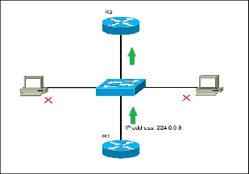
Types of IP Address
Unicast IP Address
Broadcast IP Address
Multicast IP Address
Dr. Leninisha Shanmugam VIT Chennai

Slide 28
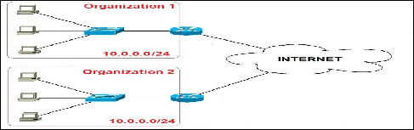
Private IP Address
Dr. Leninisha Shanmugam VIT Chennai

Slide 29
Summary
Introduction to Internet
Types of Network
Web Addressing and Organization
How information transferred from one to another
TCP / TP
Dr. Leninisha Shanmugam VIT Chennai

Slide 30
Thank You
Dr. Leninisha Shanmugam VIT Chennai

